Slide 1


Slide 2

Explain the importance of the human resource management process and the external influences that might affect that process
Discuss the tasks associated with identifying and selecting competent employees
Explain the different types of orientation and training
Describe strategies for retaining competent, high-performing employees
Discuss contemporary issues in managing human resources

Slide 3
Why Is HRM Important?
As a significant source of competitive advantage
  People-oriented HR creates superior shareholder value
As an important strategic tool
  Achieve competitive success through people by treating employees as partners
To improve organizational performance
  High performance work practices lead to both high individual and high organizational performance

Slide 4
Why Is HRM Important (cont.)?
High-performance work practices - work practices that lead to both high individual and high organizational performance

Slide 5
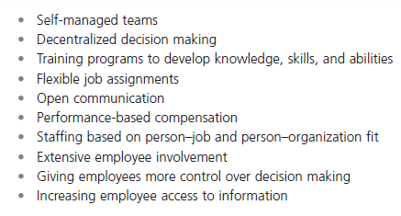
Exhibit 12-1 High Performance Work Practices
Notes:
Work practices that lead to both high individual and high organizational performance are known as high-performance work practices. (See some examples in Exhibit 12-1.)

Slide 6
External Factors
Labor union - an organization that represents workers and seeks to protect their interests through collective bargaining
Affirmative Action - organizational programs that enhance the status of members of protected groups

Slide 7
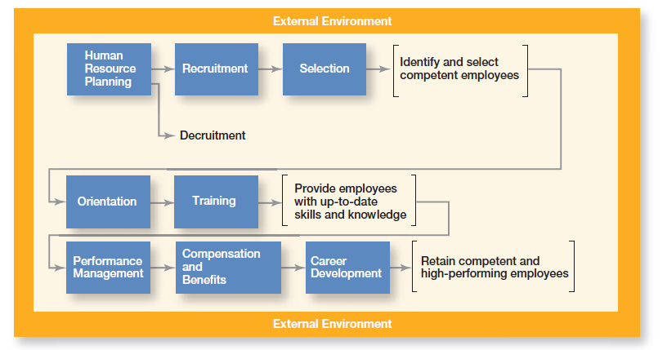
Exhibit 12-2 HRM Process
Notes:
In order to ensure that the organization has qualified people to perform the work that needs to be done—activities that comprise the RM process. Exhibit 12-2 shows the eight activities in this process

Slide 8
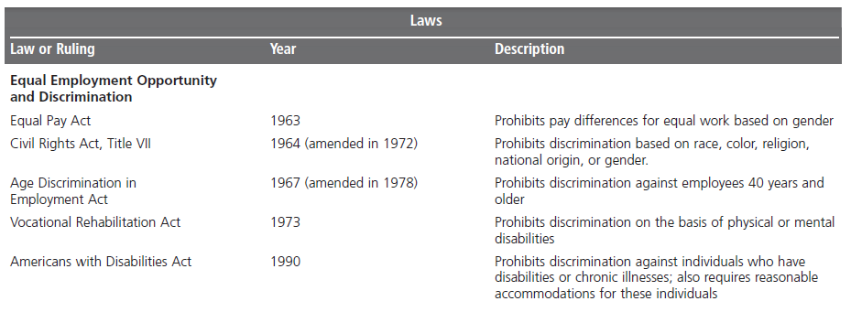
Exhibit 12-3 Major HRM Laws
Notes:
$250 million. That’s the amount a New York City jury awarded in punitive damages to plaintiffs who claim drug company Novartis AG discriminated against women.18 Billions of dollars. That’s the staggering amount that Wal-Mart Stores could potentially be liable for in a class-action sex discrimination suit.19 As you can see, an organization’s HRM practices are governed by a country’s laws. (See Exhibit 12-3 for some of the important U.S. laws that affect the HRM process.)

Slide 9
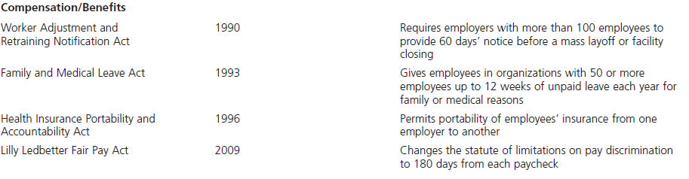
Exhibit 12-3 Major HRM Laws (cont.)

Slide 10
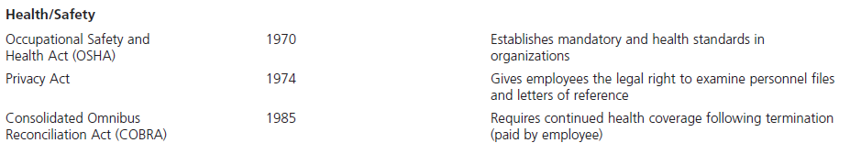
Exhibit 12-3 Major HRM Laws (cont.)

Slide 11
Representative Participation
Work councils - groups of nominated or elected employees who must be consulted when management makes decisions involving personnel
Board representatives - employees who sit on a company’s board of directors and represent the interests of the firm’s employees

Slide 12
Identifying and Selecting
Competent Employees
Human resource planning - ensuring that the organization has the right number and kinds of capable people in the right places and at the right times
Job analysis - an assessment that defines jobs and the behaviors necessary to perform them

Slide 13
Identifying and Selecting
Competent Employees (cont.)
Job description - a written statement that describes a job
Job specification - a written statement of the minimum qualifications that a person must possess to perform a given job successfully

Slide 14
Recruitment and Decruitment
Recruitment - locating, identifying, and attracting capable applicants
Decruitment - reducing an organization’s workforce

Slide 15
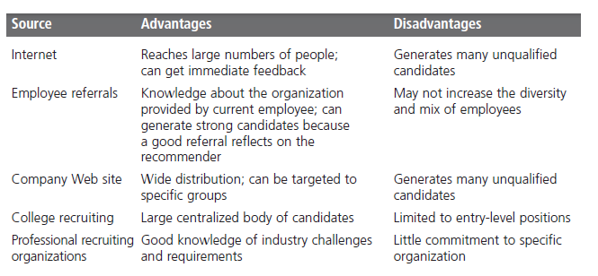
Exhibit 12-4 Recruiting Sources
Notes:
Exhibit 12-4 explains different recruitment sources managers can use to find potential job candidates

Slide 16
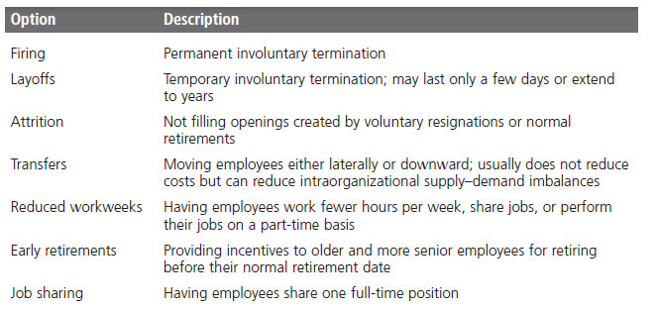
Exhibit 12-5 Decruitment Options
Notes:
The other approach to controlling labor supply is decruitment, which is not a pleasant task for any manager. Decruitment options are shown in Exhibit 12-5. Although employees can be fired, other choices may be better. However, no matter how you do it, it’s never easy to reduce an organization’s workforce

Slide 17
What is Selection?
Selection - screening job applicants to ensure that the most appropriate candidates are hired
Realistic Job Preview (RJP) - a preview of a job that provides both positive and negative information about the job and the company
Orientation - introducing a new employee to his or her job and the organization

Slide 18
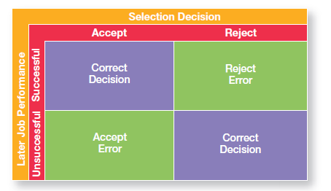
Exhibit 12-6 Selection Decision Outcomes
Notes:
As shown in Exhibit 12-6, any selection decision can result in four possible outcomes—two correct and two errors

Slide 19
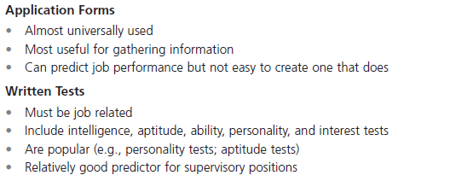
Exhibit 12-7 Selection Tools
Notes:
The best-known selection tools include application forms, written and performance-simulation tests, interviews, background investigations, and in some cases, physical exams. Exhibit 12-7 lists the strengths and weaknesses of each

Slide 20
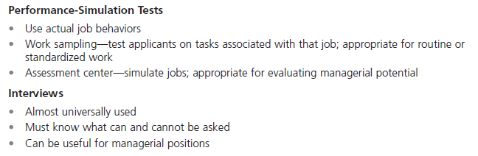
Exhibit 12-7 Selection Tools (cont.)

Slide 21
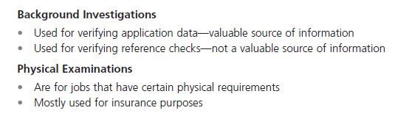
Exhibit 12-7 Selection Tools (cont.)

Slide 22
Employee Performance Management
Performance management system - establishes performance standards that are used to evaluate employee performance
Skill-based pay - a pay system that rewards employees for the job skills they can demonstrate
Variable pay - a pay system in which an individual’s compensation is contingent on performance

Slide 23
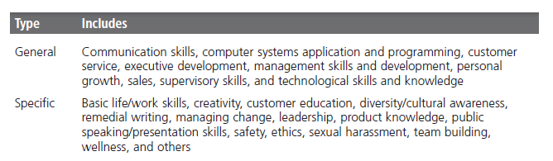
Exhibit 12-8 Types of Training
Notes:
Exhibit 12-8 describes the major types of training that organizations provide

Slide 24
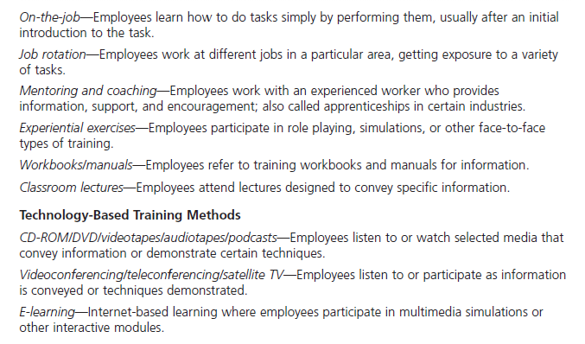
Exhibit 12-9 Traditional Training Methods
Notes:
Exhibit 12-9 provides a description of the various traditional and technology-based training methods that managers might use. Of all these training methods, experts believe that organizations will increasingly rely on e-learning applications to deliver important information and to develop employees’ skills.

Slide 25
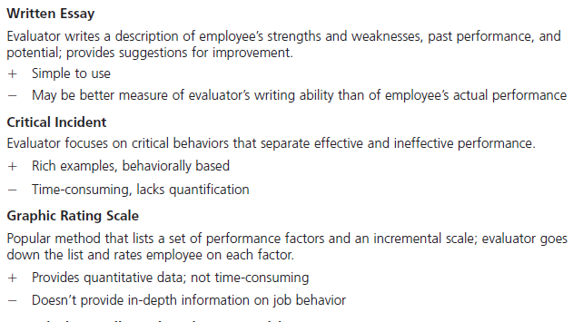
Exhibit 12-10 Performance Appraisal Methods
Notes:
Although appraising someone’s performance is never easy, especially with employees who aren’t doing their jobs well, managers can be better at it by using any of the seven different performance appraisal methods. A description of each of these methods, including
advantages and disadvantages, is shown in Exhibit 12-10.

Slide 26
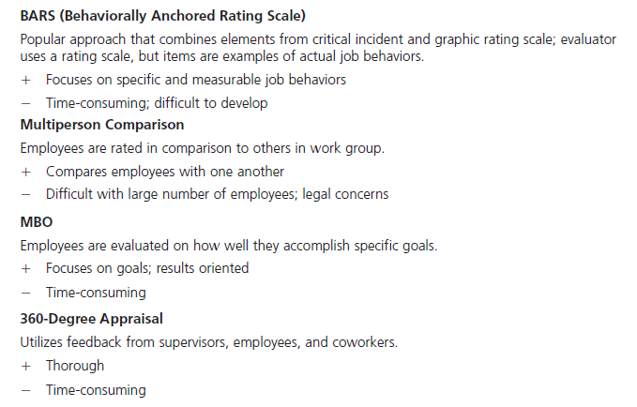
Exhibit 12-10 Performance Appraisal Methods (cont.)
Notes:
MBO management by objective

Slide 27
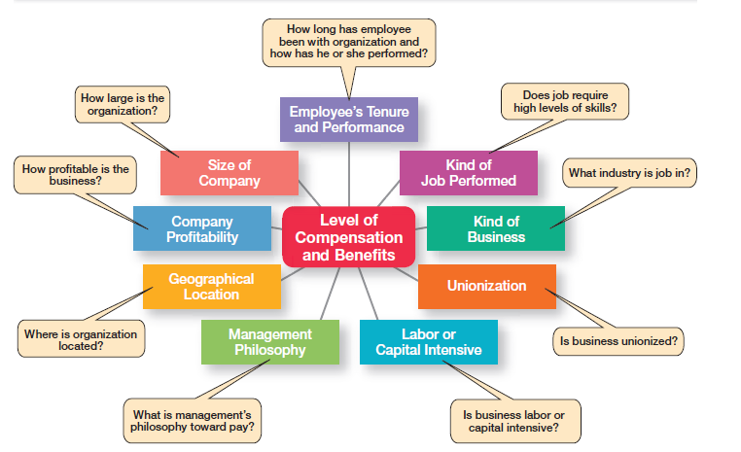
Exhibit 12-11 What Determines Pay and Benefits
Notes:
How do managers determine who gets paid what? Several factors influence the compensation and benefit packages that different employees receive. Exhibit 12-11 summarizes these factors, which are job-based and business- or industry-based. Many organizations,
however, are using alternative approaches to determining compensation: skill-based pay and variable pay.

Slide 28
Contemporary Issues in Managing
Human Resources
Downsizing - the planned elimination of jobs in an organization
Sexual harassment - any unwanted action or activity of a sexual nature that explicitly or implicitly affects an individual’s employment, performance, or work environment

Slide 29
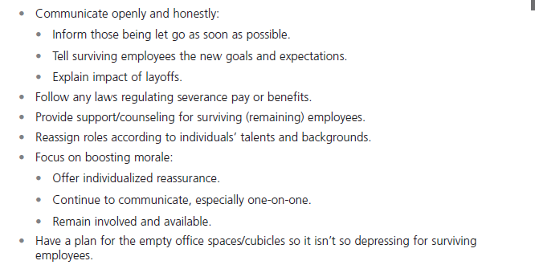
Exhibit 12-12 Tips for Managing Downsizing
Notes:
How can managers best manage a downsized workplace? Disruptions in the workplace and in employees’ personal lives should be expected. Stress, frustration, anxiety, and anger are typical reactions of both individuals being laid off and the job survivors. Exhibit 12-12 lists some ways that managers can lessen the trauma both for the employees being laid off and for the survivors

Slide 30

Managing Work–Life Balance
Family-friendly benefits - benefits that accommodate employees’ needs for work–life balance

Slide 31
Terms to Know
high-performance work practices
human resource management process
labor union
affirmative action
human resource planning
job analysis
job description
job specification
recruitment
decruitment
selection
validity
reliability
work sampling
assessment centers
realistic job preview (RJP)
orientation
performance management system
written essay
critical incidents
graphic rating scales

Slide 32


